Slide 1

Video Games
Basic study of worldwide video game sales and platforms

Slide 2
Video GAmes
Video games have been a part of the entertainment industry for decades now. In 2017, it is estimated that video games grossed over $116 billion in revenue worldwide. In the year 2020, this number is expected to grow to $143 billion.
In 2017, Nintendo has been ranked as the second biggest company in terms of sales with a sales volume of $6.4 billion and a market share of 23%. Sony ranks first with a sales volume of $8.7 billion and a market share of 31%. Sony’s PlayStation 4 has been leading the console market since its release in November 2013, with an installed base more than 60% higher than Nintendo’s Switch.
In 2016, Microsoft was ranked third with a sales volume of $5.1 billion and a market share.

Slide 3
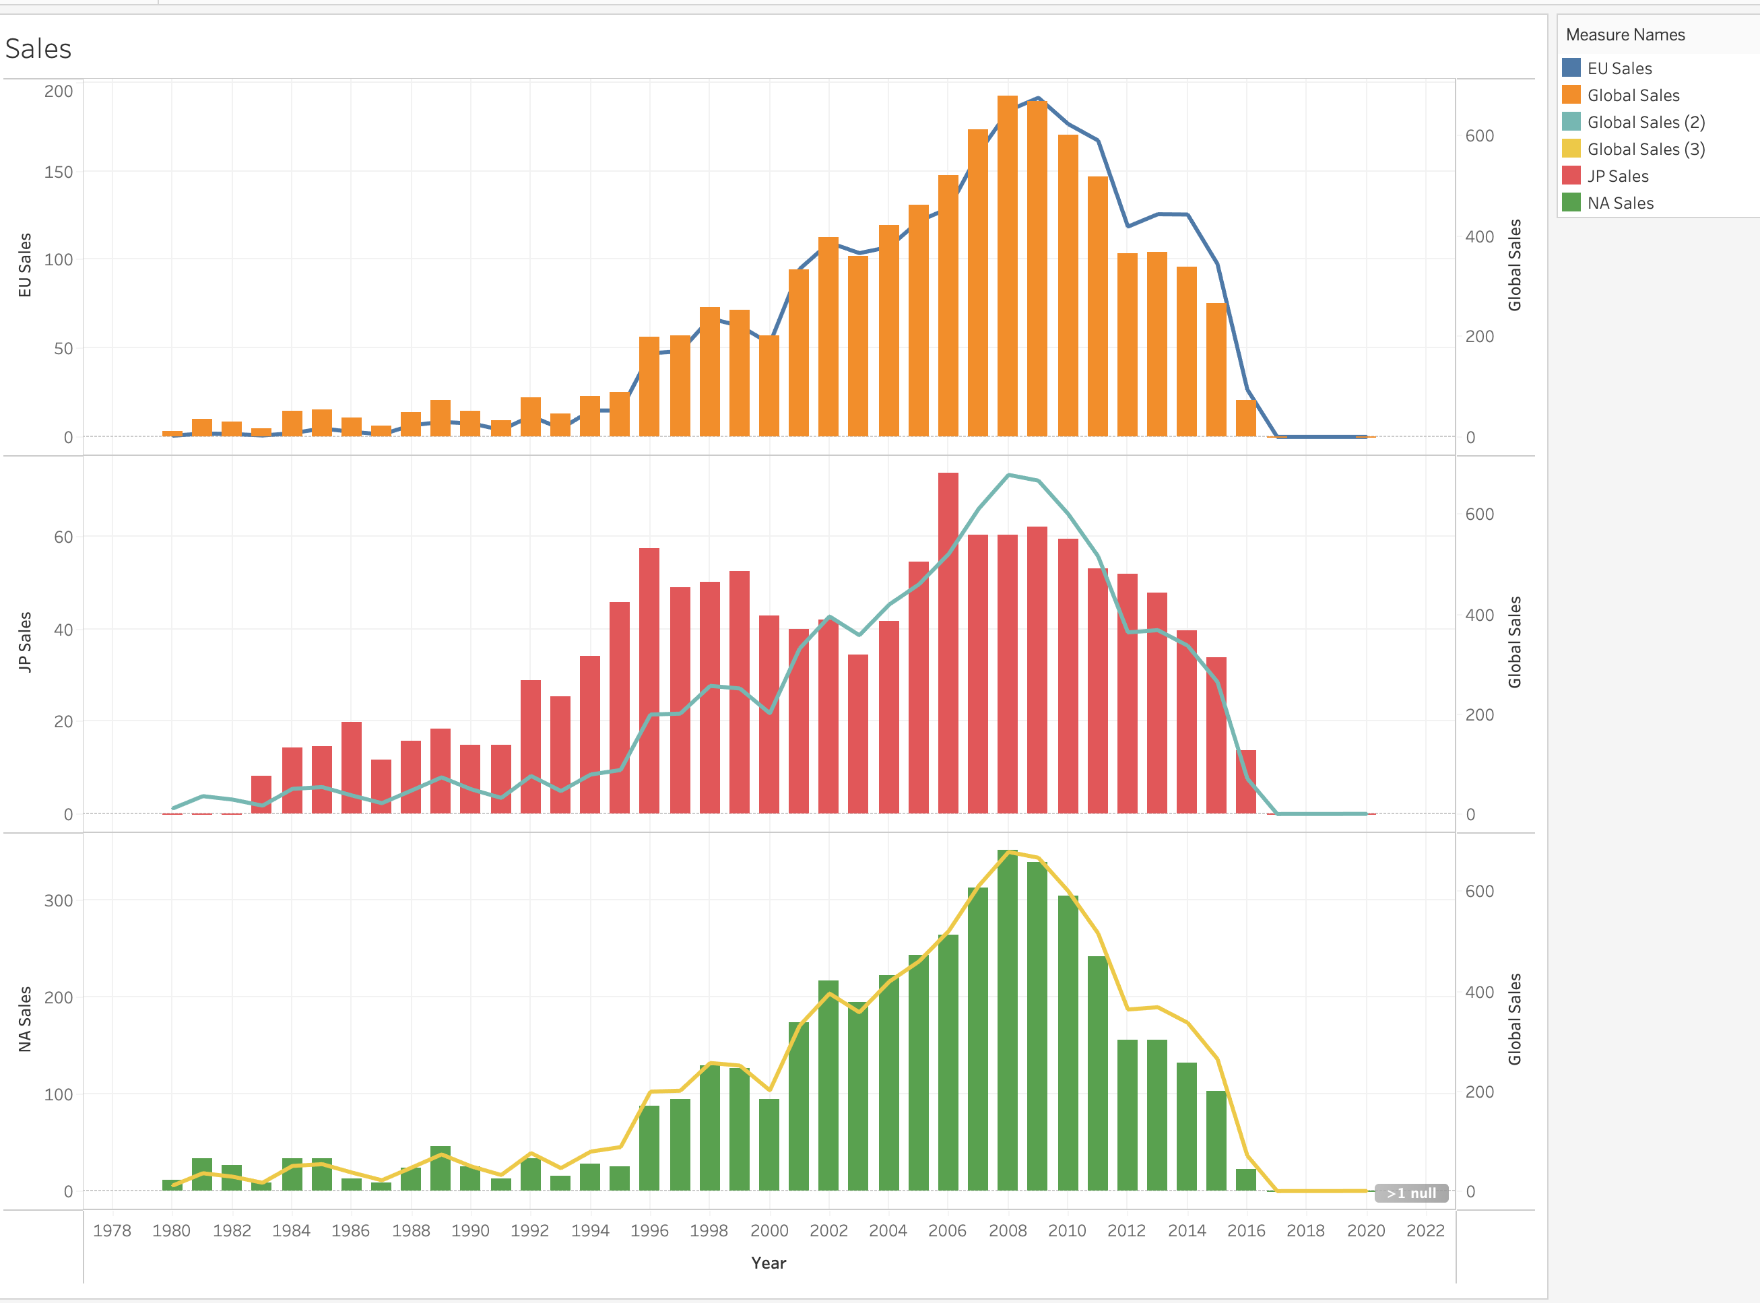
How video game sales have been trending over time

Slide 4
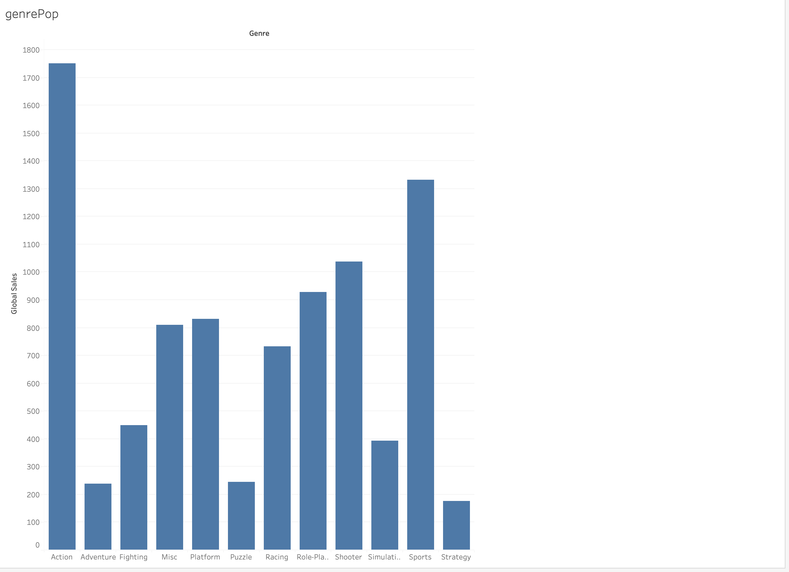
The most popular genre of video game

Slide 5
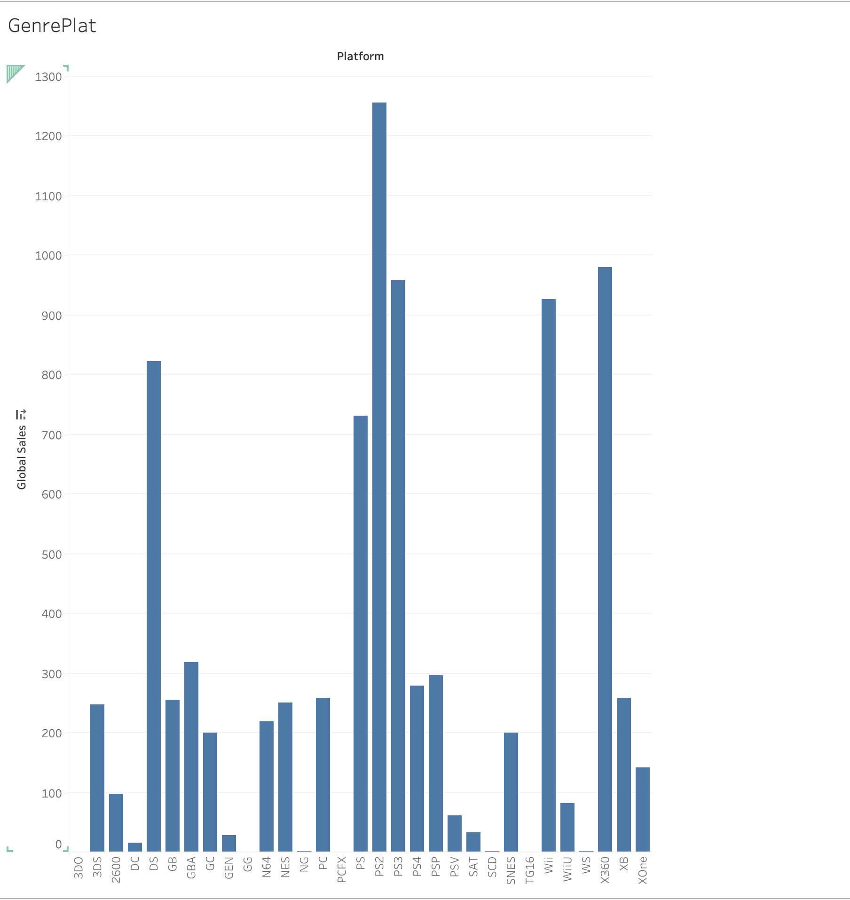
A comparison of video game platforms by genre

Slide 6
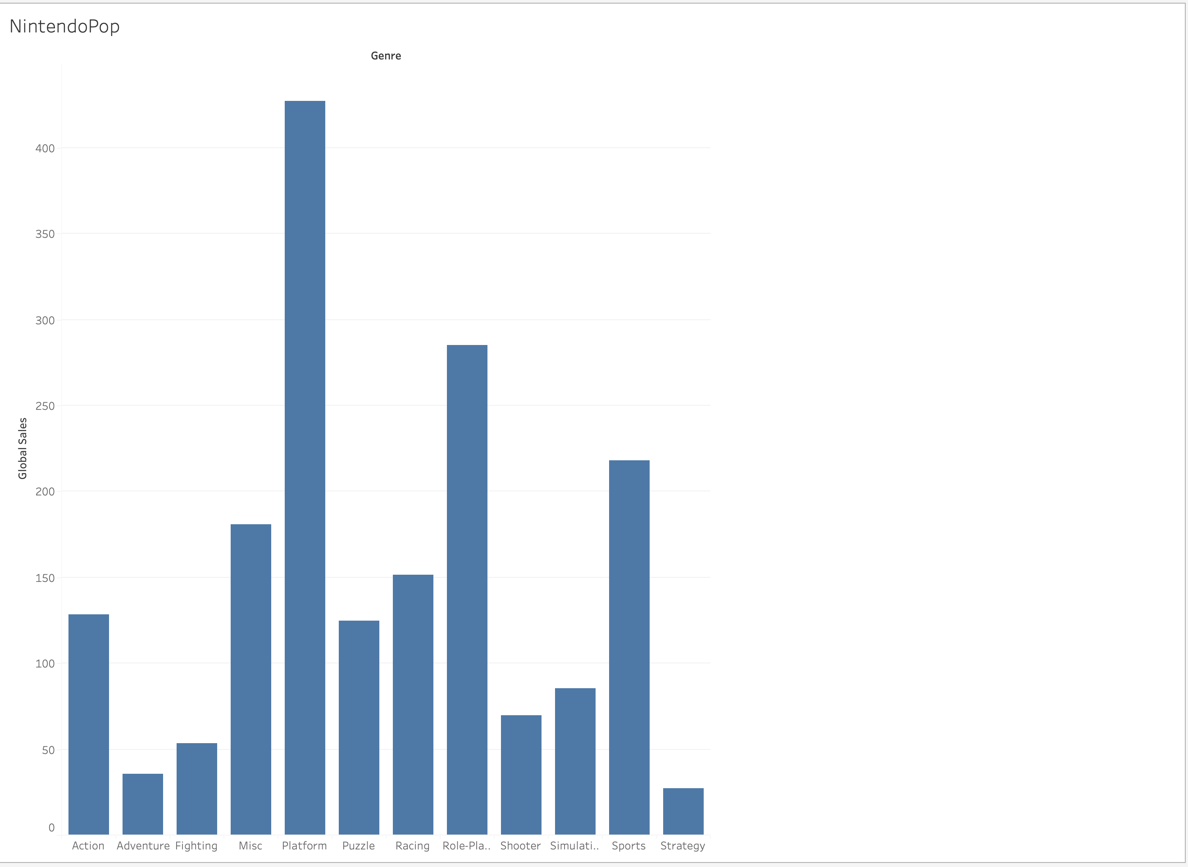
A visual looking at only games by Nintendo

